Slide 1

NASI SPONSORZY I PARTNERZY

Slide 2
SQL Server Cardinality Estimation
Paweł Potasiński
Maciej Pilecki

Slide 3
Agenda
What is Cardinality Estimation?
Why does it matter?
How it happens?
Changes in SQL Server 2014

Slide 4
Cardinality
car·di·nal·i·ty
noun: cardinality; plural noun: cardinalities
the number of elements in a set or other grouping, as a property of that grouping.
Po polsku: moc zbioru

Slide 5
What is Cardinality Estimation
SQL Server uses COST-BASED Query Optimizer
Estimated Cost depends on two factors:
Type of operators in the plan
Number of rows going through each operator (cardinality of the set)
That numer of rows is estimated by the Cardinality Estimator
Based on:
Statistics
Query predicates

Slide 6
Why Does It Matter?
Estimated numer of rows affects Estimated Cost of each operator
That cost is used to predict the Estimated Cost of the plan
Plan cost affects choice of plan.
Choice of plan affects perfomance.
That means that:
Cardinality Estimation affects performance of your queries!

Slide 7
When it does NOT work?
Comparisons between columns of the same table (a>b)
Local variables
Functions with non-constant parameters
No statistics on columns

Slide 8
Statistics
Density information for columns in statistics.
Some maths:
Density = 1 / Distinct Value Count
Frequency = Row Count * Density
Selectivity of P = Row Count satisfying P / Row Count

Slide 9
Statistics basics
Demo

Slide 10
Cardinality Estimator Assumptions
Independence
Uniformity
Containment
Inclusion

Slide 11
SQL Server 2014 - New Cardinality Estimator
Side-by-side reimplementation of CE
Legacy CE since SQL Server 7.0 ("70" vs "120")
CardinalityEstimationModelVersion attribute in XML query plans
Trace flags – 2312 (new CE) and 9481 (legacy CE)
ALTER DATABASE [AdventureWorks2012] SET COMPATIBILITY_LEVEL = 120;

Slide 12
New CE - Changes
Increased Correlation Assumption for Multiple Predicates
Modified Ascending Key and Out-Of-Range Value Estimation
Join Estimate Algorithm
Multiple Join Conditions
Joins with Equality and Inequality Predicates
Join Containment Assumption
Distinct Value Count Estimation

Slide 13
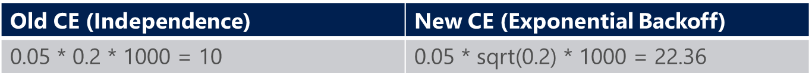
Increased Correlation Assumption for Multiple Predicates
A query with multiple predicates combined with “and”:
1000 Rows. 200 Suuntos. 50 Ambits.
SELECT *
FROM dbo.Products
WHERE Make = 'Suunto' AND Model = 'Ambit';
Answer: 50 Rows.

Slide 14
Equijoin with Two or More Predicates
Take the lesser of the Distinct Value Counts between two inputs
(10)
Multiply by Average Frequencies from both inputs
(10 * 1 * 14.4 = 144)
T1.a 12 Distinct values, 12 rows
T1.a=T2.a
T1.b = T2.b
Old CE: ??
Result: 10 Distinct Values, 144 rows
T2.a 10 Distinct Values, 144 rows
Assume all match!

Slide 15
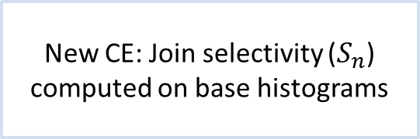
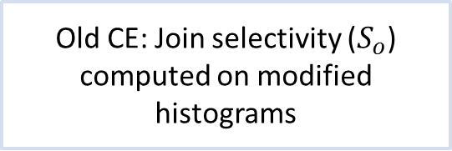
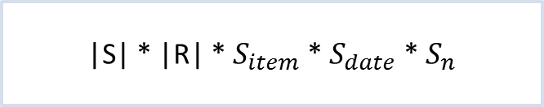

Join Containment Assumption
SELECT *
FROM dbo.Sales AS s CROSS JOIN dbo.Returns AS r
WHERE s.ticket = r.ticket AND s.type = 'Watch' and r.date = '20131219'
Old CE: Join selectivity ($S_{o}$) computed on modified histograms
New CE: Join selectivity ($S_{n}$) computed on base histograms
Sales
Toys
S.Ticket = R.Ticket
|S| * |R| * $S_{item}$ * $S_{date}$ * $S_{n}$
|S| * |R| * $S_{o}$
Returns
2013-12-19

Slide 16
NEW CE vs Legacy CE
Demo

Slide 17
Incremental Statistics
A feature targeted for partitioned tables
Assuming most updates in newest partitions
To create
One statistical object for each partition
Binary merge of partial statistics
A complete tree of statistics persisted
To Update
Rebuild statistics on a subset of partitions
Merge with rest of the statistics tree

Slide 18
T-SQL
CREATE STATISTICS stat ON tbl (col1, col2)
WITH INCREMENTAL = ON
UPDATE STATISTICS tbl (stat)
WITH RESAMPLE ON PARTITIONS (1, 3, 5)
UPDATE STATISTICS tbl (stat)
WITH INCREMENTAL = { ON | OFF }
ALTER DATABASE db
SET AUTO_CREATE_STATISTICS ON (INCREMENTAL = { ON | OFF })

Slide 19
Impact on Queries
Still uses global stats for query optimization
No per-partition stats for optimization yet
Threshold for auto stats update and query recompile
To update global: 500 + 20% of average partition size
To update per-partition: 20% data change in a partition
Default sample rate for incremental stats
Auto create : same default sample rate as regular stats
Auto update: using most recent sample rate

Slide 20
Incremental Statistics
Demo

Slide 21
Summary
Cardinality Estimation matters!
Be aware of the changes in SQL 2014
Most queries should benefit from better cardinality estimation
But there might be regression, so know how to revert to old behaviour

Slide 22
Thank you!
Questions?

Slide 23

NASI SPONSORZY I PARTNERZY
Organizacja: Polskie Stowarzyszenie Użytkowników SQL Server - PLSSUG

